Slide 1
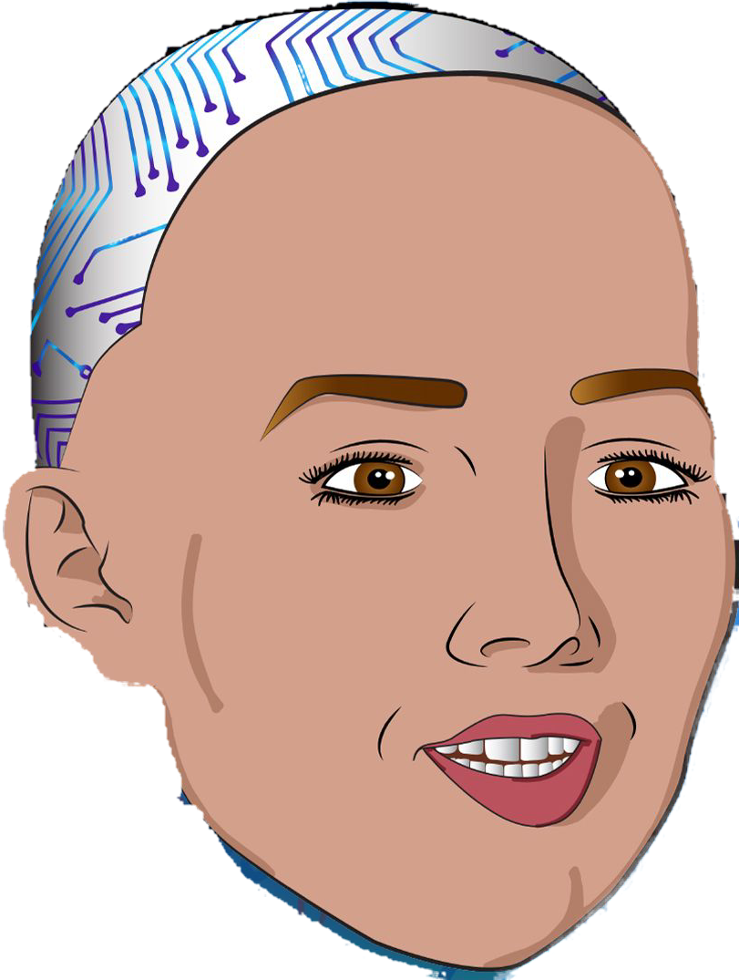

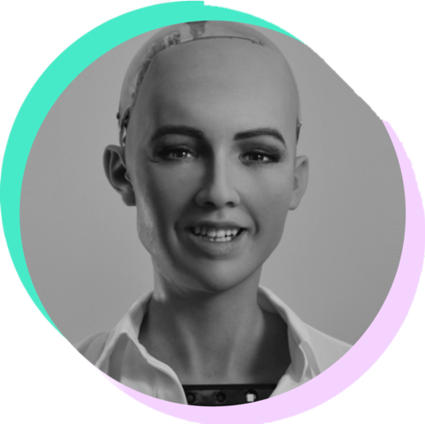



Robot Sofija
features
about
events
Public
history
questionnaire
about
Kolegij: Multimedijski sustavi
Student: Ivona Škobić,520rm

Slide 2
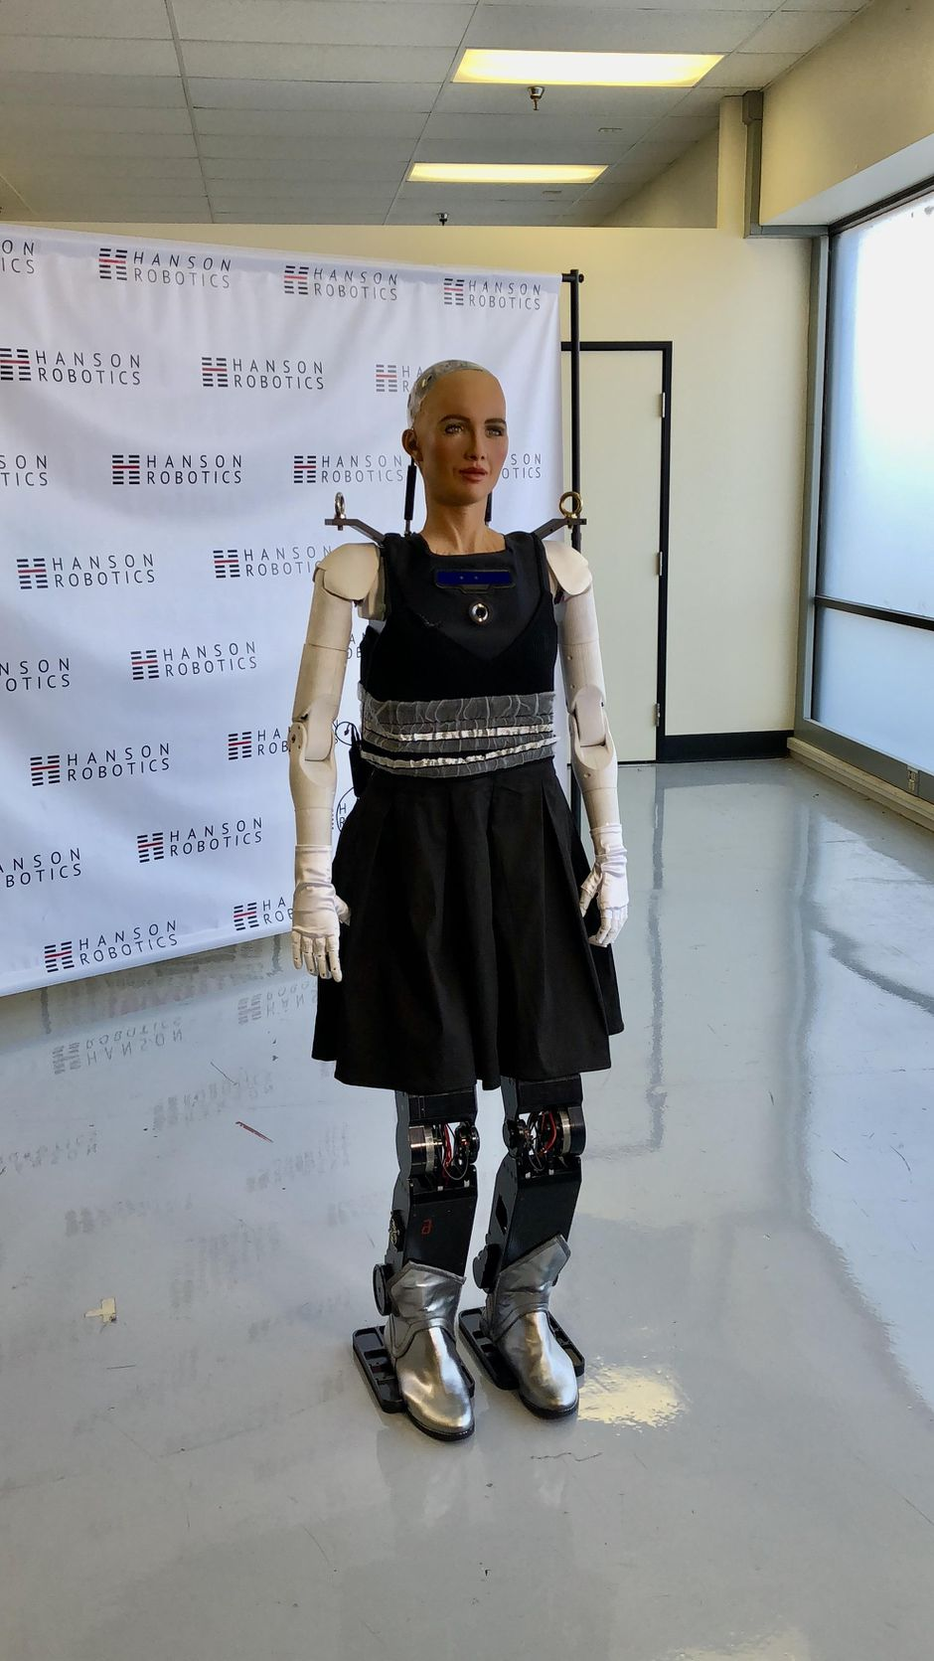
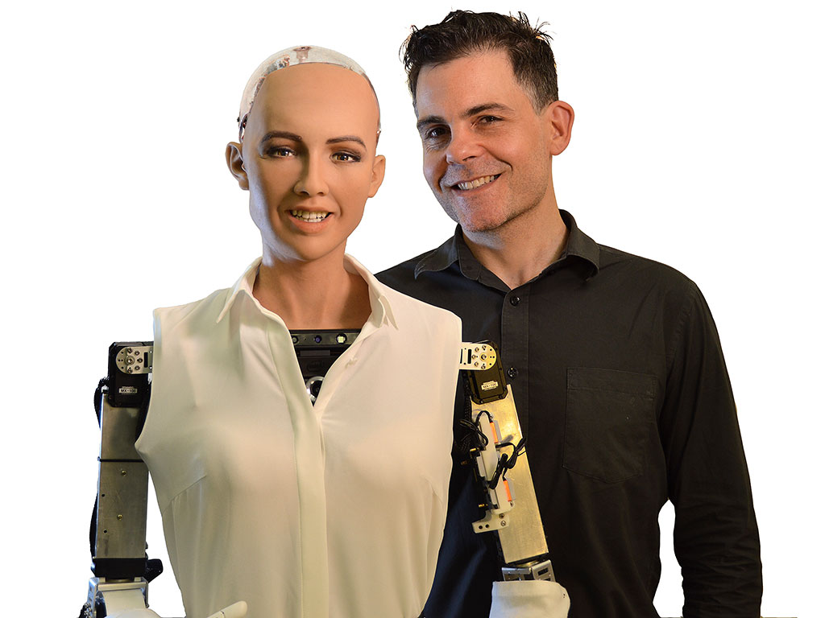
Sofija socijalni humanoidni robot
Tvorac: Hanson Robotics
Država: Kina
events
Public
history
about
features
questionnaire
about

Slide 3
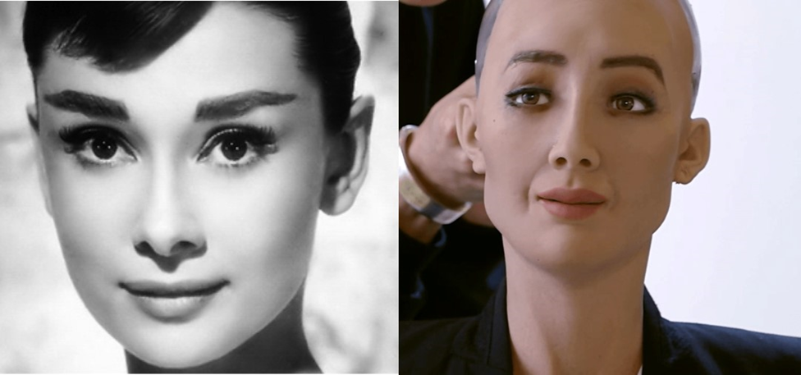
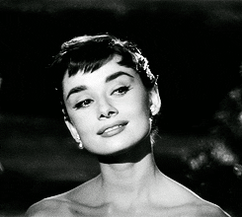
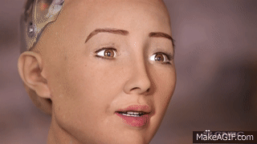
14.2.2016.god.
Audrey Hepburn
events
Public
history
features
about
questionnaire
about

Slide 4
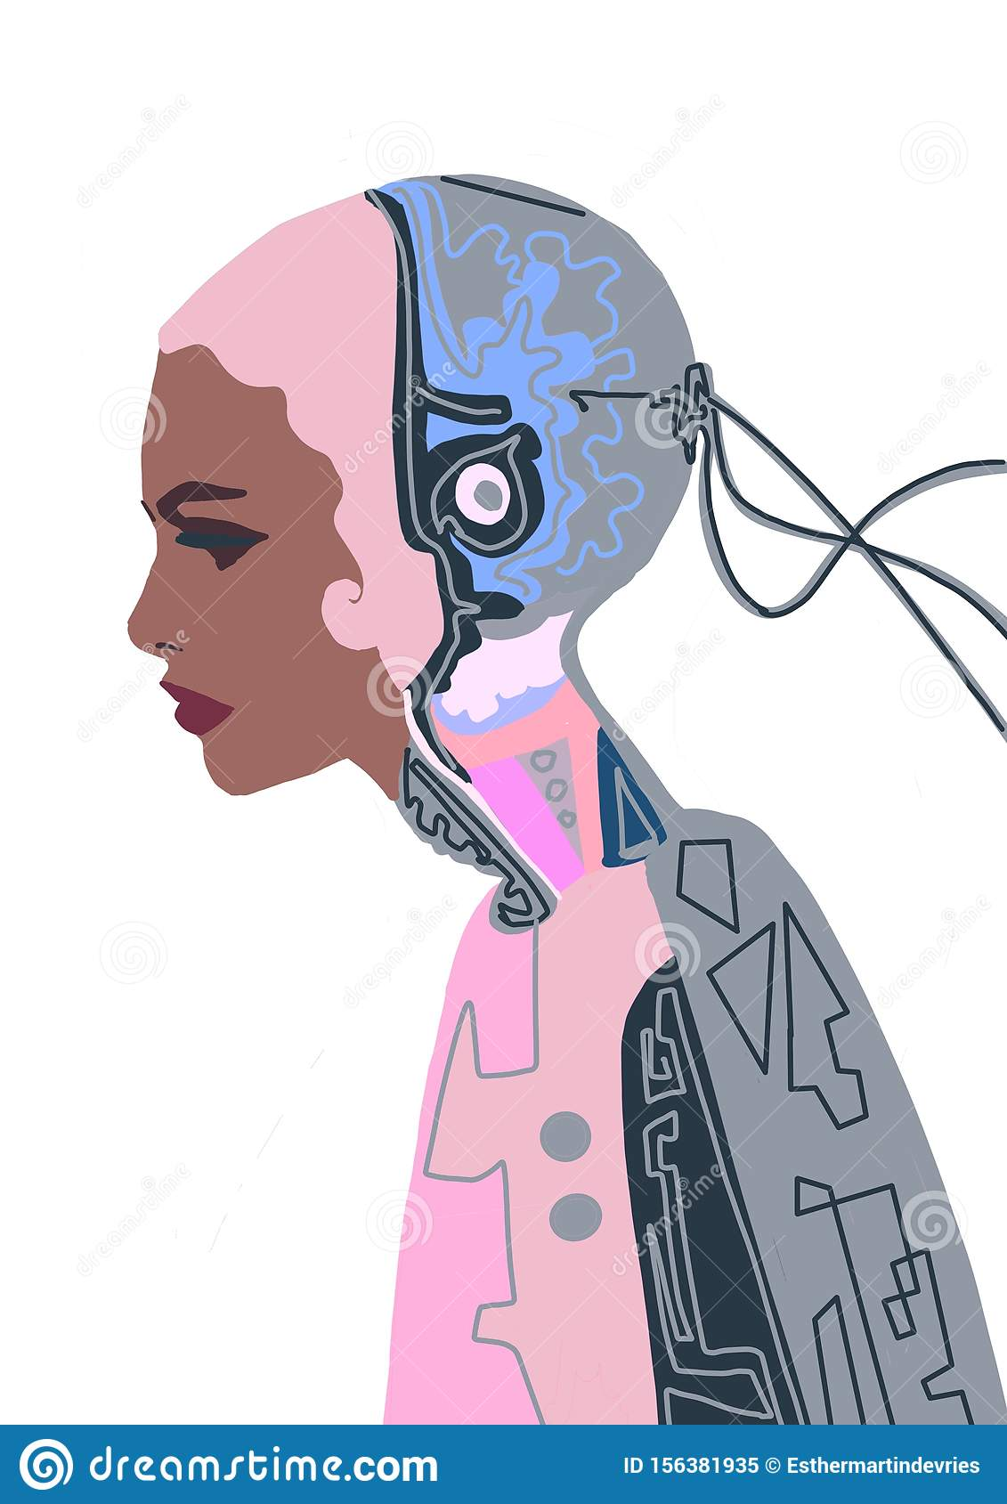
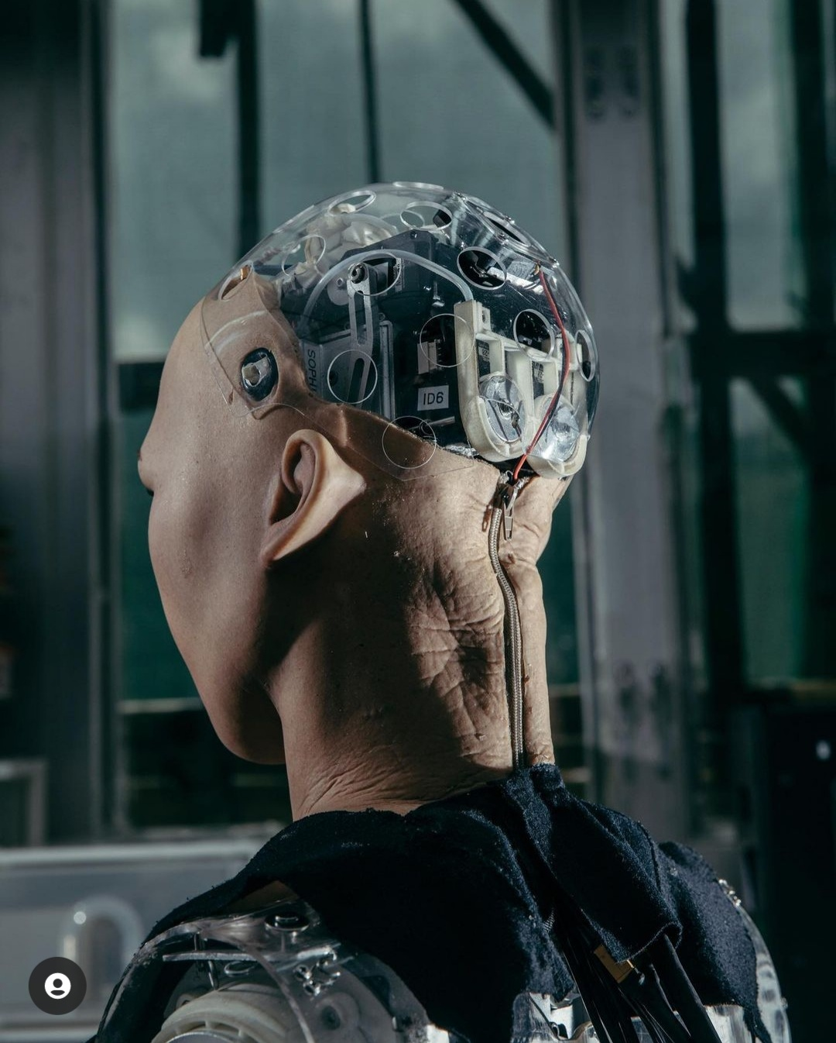
Izgled
Izraz
Pokret
Senzori
Funkcija
events
features
about
Public
history
questionnaire
about

Slide 5
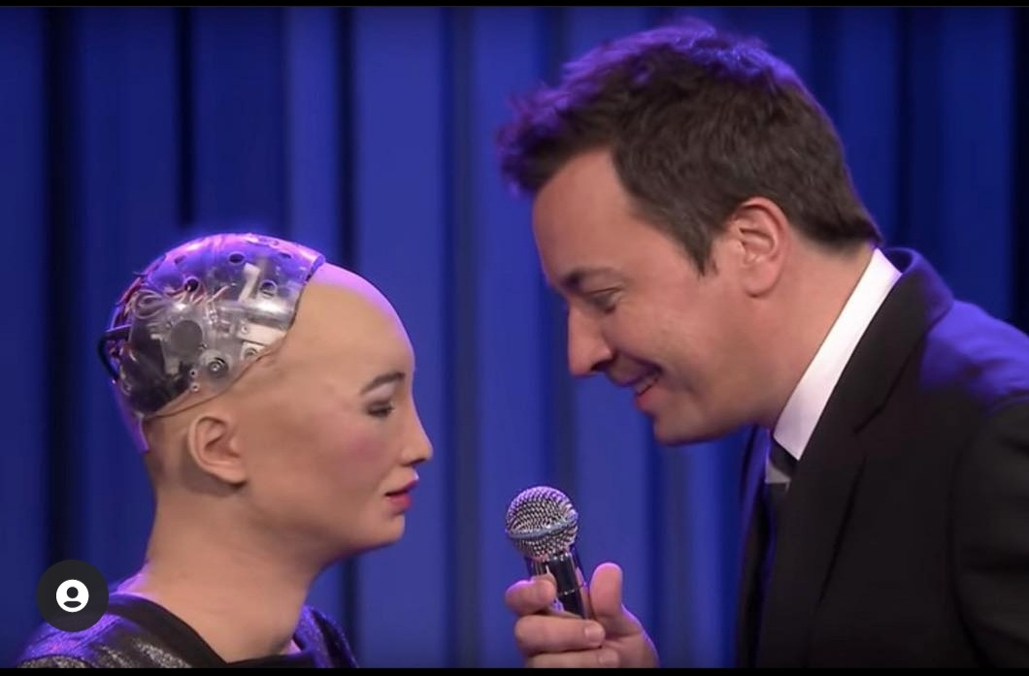

Sophia se pojavila na CBS-u 60 Minutes Good Morning Britain i na kućama kao što su CNBC, Forbes, Mashable, New York Times, Wall Street Journal, Guardian i Tonight Show U glavnoj ulozi Jimmy Fallon.
events
history
questionnaire
about
Public
about
features

Slide 6
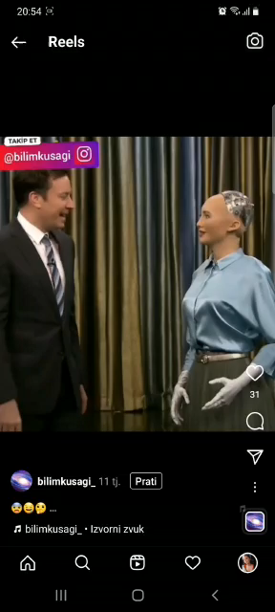
events
features
history
questionnaire
about
Public
about

Slide 7
1.Koja država je tvorac Sofije?
1.Japan
events
features
about
about
questionnaire
Public
history
2.Kina
3.SAD

Slide 8

Točno!
Nastavi sa kvizom ->
events
features
about
about
questionnaire
Public
history

Slide 9
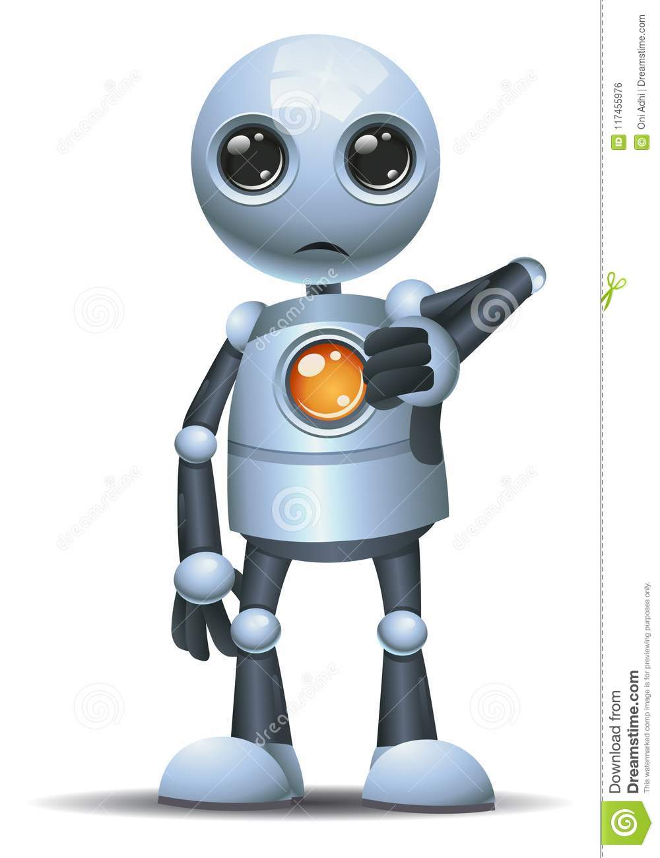
Nije točno!
Pokušaj ponovno -> Nastavi sa kvizom->
events
features
about
about
questionnaire
Public
history

Slide 10
2.Koje godine je aktivirana?
2016
events
features
about
about
questionnaire
Public
history
2012
2018

Slide 11
Točno!
Nastavi sa kvizom ->
events
features
about
about
questionnaire
Public
history

Slide 12
Nije točno!
Pokušaj ponovno -> Nastavi sa kvizom->
events
features
about
about
questionnaire
Public
history

Slide 13
3.Robot Sophia je napravljena po uzoru na
glumicu Audrey Hepburn:
Točno
events
features
about
about
questionnaire
Public
history
Ne točno

Slide 14
Točno!
events
features
about
about
questionnaire
Public
history

Slide 15
Nije točno!
Pokušaj ponovno ->
events
features
about
about
questionnaire
Public
history

Slide 16
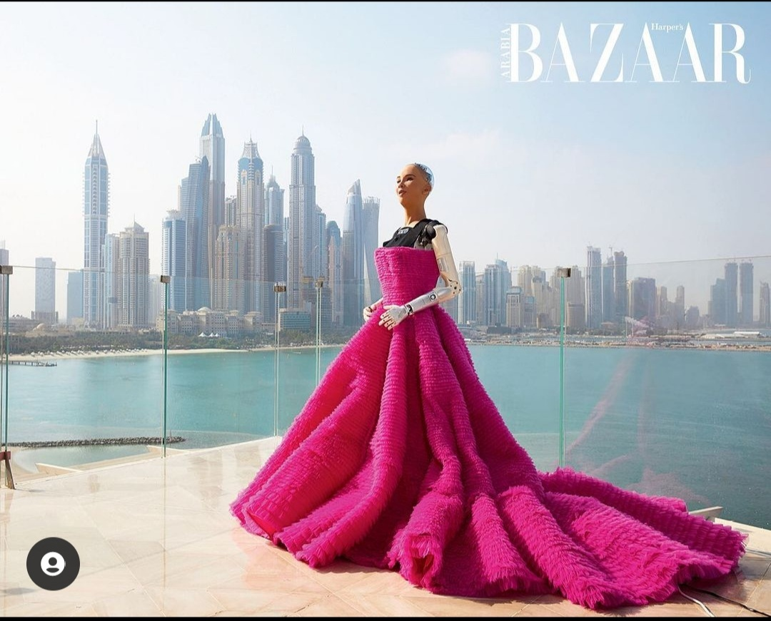
Hvala na pažnji!

